Slide 1
Lab Assignment # 2 Proposal Articles
PSY 15
Mandy Small
February 3, 2021

Slide 2
Peer Review
The goal of peer review is to assess the quality
Submission
Review by editor and experts in the field.
Reviewers specialize in the same scholarly area as the author = peer review
The peer reviewers check for accuracy, validity of the research methodology and procedures, and scientific contribution.
Acceptance, Review and Resubmit, or Rejection

Slide 3
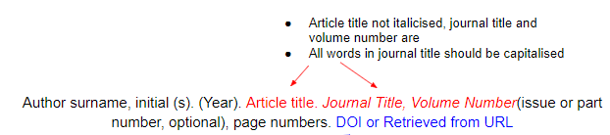
APA Reference Format
Purdue University OWL (https://owl.purdue.edu/owl/research_and_citation/apa_style/)
Never trust the database generated APA references, there is almost always at least one error

Slide 4
Tips for Success
The right database
PsychINFO
First 5 vs. Best 5
Search Terms/ Key words
identifying the main concepts of your topic
brainstorming synonyms and antonyms that could also be used to describe your topic

Slide 5
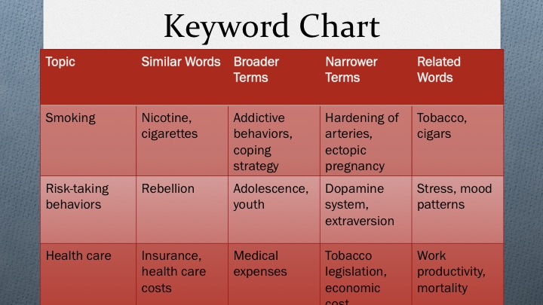

Slide 6
Instructions
For your selected research topic, find 5 relevant peer-reviewed articles and submit the APA reference and abstract for each.
State your research question
Identify the independent and dependent variable
List the 5 articles (using APA formatting) and abstracts
Assignment #2 is worth 15 points

Slide 7
Formatting and Due Date
Type this assignment
12 point, Times New Roman font.
Use APA formatting for the references.
The references should be double spaced, but the abstracts should be single spaced.
Include your name and section number.
Submit your work to CatCourses by 11:59 PM on February 10, Wednesday (no late work will be accepted).
Pdf format only

Slide 8
